Slide 1
Data Warehouse Project Presentation
Team members:
Dylan Dias
Kunal Joshi
Thulasi Amaraneni

Slide 2
Table of Contents
Data Mart Universe of Discourse
Information Package chart
Entity Definitions
Physical dimensional model
Data-Staging Extract Report
Source-to-Target Mapping Dictionary
SQL Schema Code
Data Cleansing Activities
Data Transformation Processes
Table Population Processes & Activities
End-User Applications
Slowly Changing Dimensions
N-M Implementation

Slide 3
Data Mart Universe of Discourse
For the financial control and analysis of the TPC-E, PEC and TPC-W sales based on annually, quarterly, monthly, weekly, daily basis is the universe of discourse of the project.
Scope:
The scope of this project lies in analyzing product sales of TPC-E, PEC and TPC-W based on annually, quarterly, monthly, weekly, daily basis.

Slide 4
Information Package chart
Process Definition:
The process involves the Financial Control and Analysis of TPC-E, PEC, TPC-W divisions sales.
Grain:
Individual Product Sale by every customer is analyzed.
Dimensions and Attributes:
Customer_Dim: Customer_SK, custID, name, Addr1, Addr2, city, state, zip, CUSTTYPEID, TYPENAME
Product_Dim: Product_SK, ProductID, ProductName, Price1, Price2, UnitCost, SupplierName, SupAddress1, SupAddress2, City, State, Zip, PRODTYPEID, TYPEDESCRIPTION, BUID, NAME, ABBREV
Junk_Dim: Junk_SK, Shippingmethod, Paymentmethod, Orderingmethod
Salesdate_Dim: SalesDate_SK, SalesDate, Year, Quarter, Month, Week, Day, FiscalYear, FiscalQuarter, FiscalMonth, FiscalWeek, FiscalDay
Orderdate_Dim: OrderDate_SK, OrderDate, Year, Quarter, Month, Week, Day, FiscalYear, FiscalQuarter, FiscalMonth, FiscalWeek, FiscalDay
Facts:
InvoiceID, Amt, Qty, Discounted, ShipCost, Sales_By

Slide 5
Entity Definitions
Customer_Dim:
Customer dimensions exists in all the three divisions i.e. TPC-E, TPC-W, PEC. It consists of details of the customer who had a transaction on product.
Product_Dim:
It consists of details about the products that are to be sold in Product dimensions.
Junk_Dim:
This dimensional table includes the attributes that do not fall into either fact or dimensional tables.
Salesdate_Dim:
This dimension represents the sale date of the product by a customer.
Orderdate_Dim
This dimension represents the order date of the product by a customer.
Fact
It is the fact table for the schema which retrieves the facts of the model
The attributes data type and description are briefly explained in the report.

Slide 6
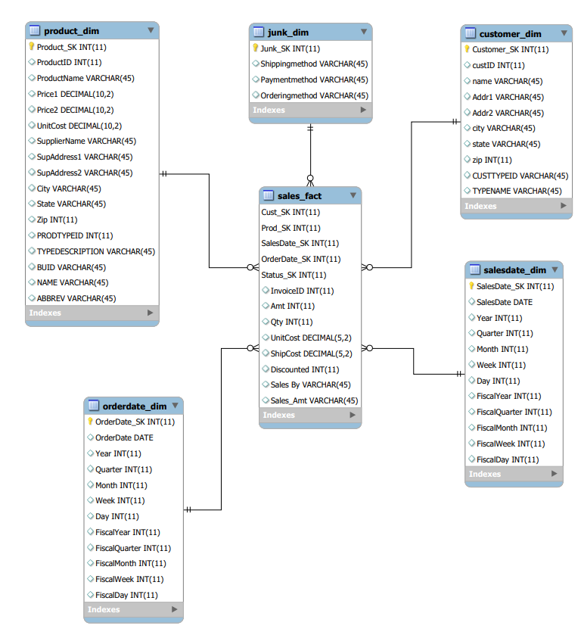
Physical dimensional model

Slide 7
Physical dimensional model
In this model, we have five dimensions such as Product, Junk, Customer, Order date, Sales date.
Sales Fact is a Fact table.
In this Fact table, we calculate Quantity, Unit cost, Discount etc.
Invoice ID is a degenerate dimension.
The grain i.e., the lowest level of detail is a single sale across all divisions name as PEC, TPC-E, TPC-W over year, quarter, month, week and date.
Customer_SK, Product_SK, Junk_SK, SalesDate_SK, OrderDate_SK are the surrogate keys in the Customer, Product, Junk, SalesDate and OrderDate dimension tables respectively.
Customer_type table has been denormalized to have one-dimension table for Customer across all attributes.
Product_type and Business Unit tables have been denormalized to have one-dimension table for Product across all attributes

Slide 8
Data-Staging Extract Report
In the ETL process, we extracted the source data from various files which were mainly in the .csv format of divisions TPC_E, TPC-W, and PEC..
For Customer dimension, extracted source data from customer.csv, customer_type.csv, TPCWcustomer.csv, TPCWcustomer_type.csv, PECcustomer.csv, PECcustomer_type.csv.
For Junk dimension, extracted source data from PECinvoice.csv.
For Product dimension, extracted source data from product.csv, prod_type.csv, business_unit.csv, supplier.csv.
For SalesDate dimension, the attribute salesdate was extracted from the invoice of all the divisions.
For OrderDate dimension, the attribute orderdate was extracted from the invoice of all the divisions.

Slide 9
Source-to-Target Mapping Dictionary
•In ETL process, during source to target mappings, we performed various data transformation activities by mainly using Pentaho tool.
•In OrderDate dimension table, orderDate column is extracted from PECinvoice.csv file. By using calculator option in Pentaho, extracted year, quarter, month, week, day from orderDate.
•For OrderDate dimension table, by using modified JavaScript option in PENTAHO, Calculated the FiscalYear, FiscalQuarter, FiscalMonth, FiscalWeek.
•Performed similar operations in case SalesDate dimension table.
•In sales_fact table, by using Pentaho removed Null values.

Slide 10
SQL SCHEMA CODE
The code to create a schema with the dimensions Customer, Product, Junk, SalesDate, OrderDate and the sale_fact fact table is been created. Also, the corresponding constraints are also created that includes PRIMARY KEY, FOREIGN KEY, SURROGATE KEY, NATURAL KEY.

Slide 11
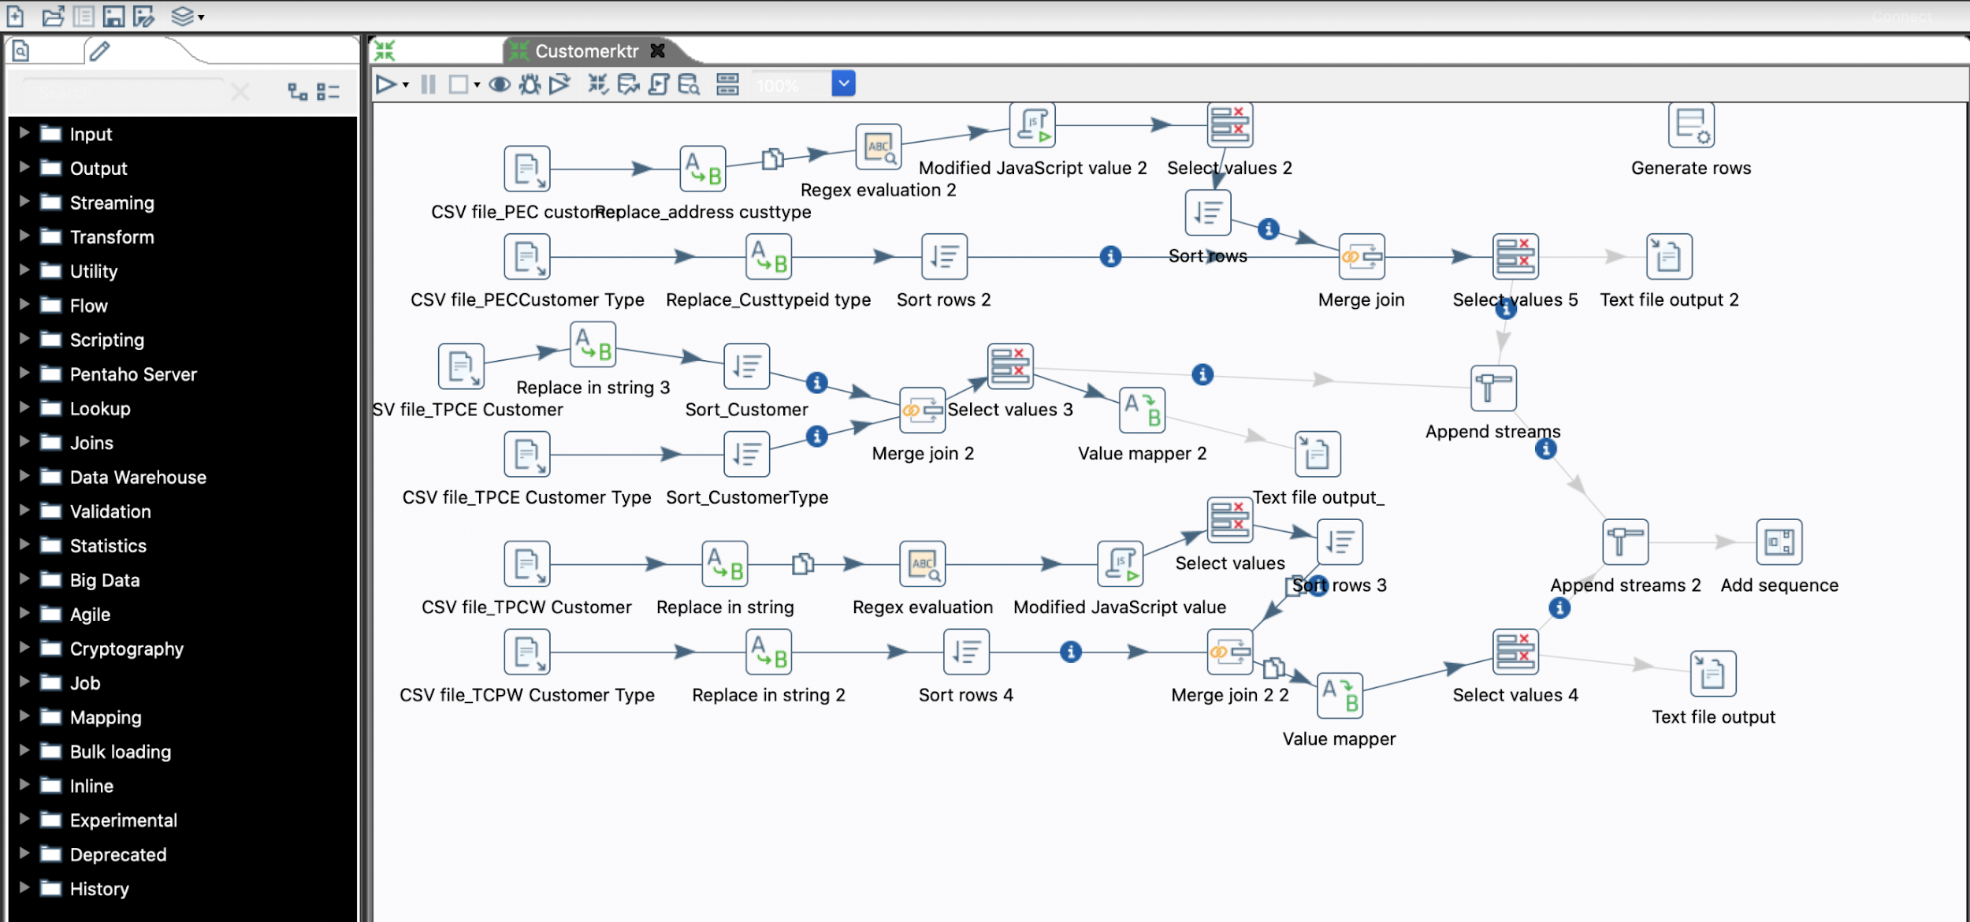
Data Staging Activities - ETL (Includes Data Cleaning and Data Transformation Activities)
Customer Dimensional KTR:
Cleansed: Address, Name, CustType, TYPENAME.
Standardized and made consistent:
state, city, zip code.

Slide 12
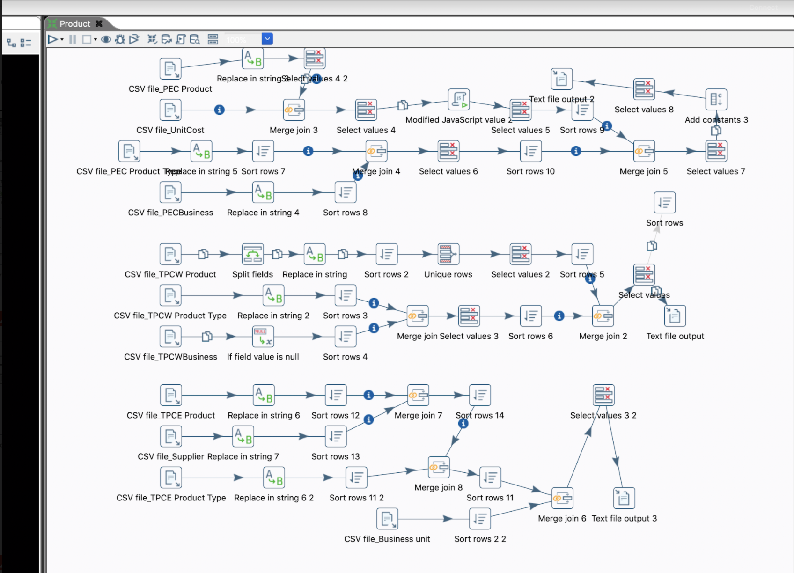
Data Staging Activities - ETL (Includes Data Cleaning and Data Transformation Activities)
Product Dimensional KTR:
Cleansed: Address, city, desc, SupplierName
Standardized and made consistent:
Address, city, desc, SupplierName
Included supplier in the product table.

Slide 13
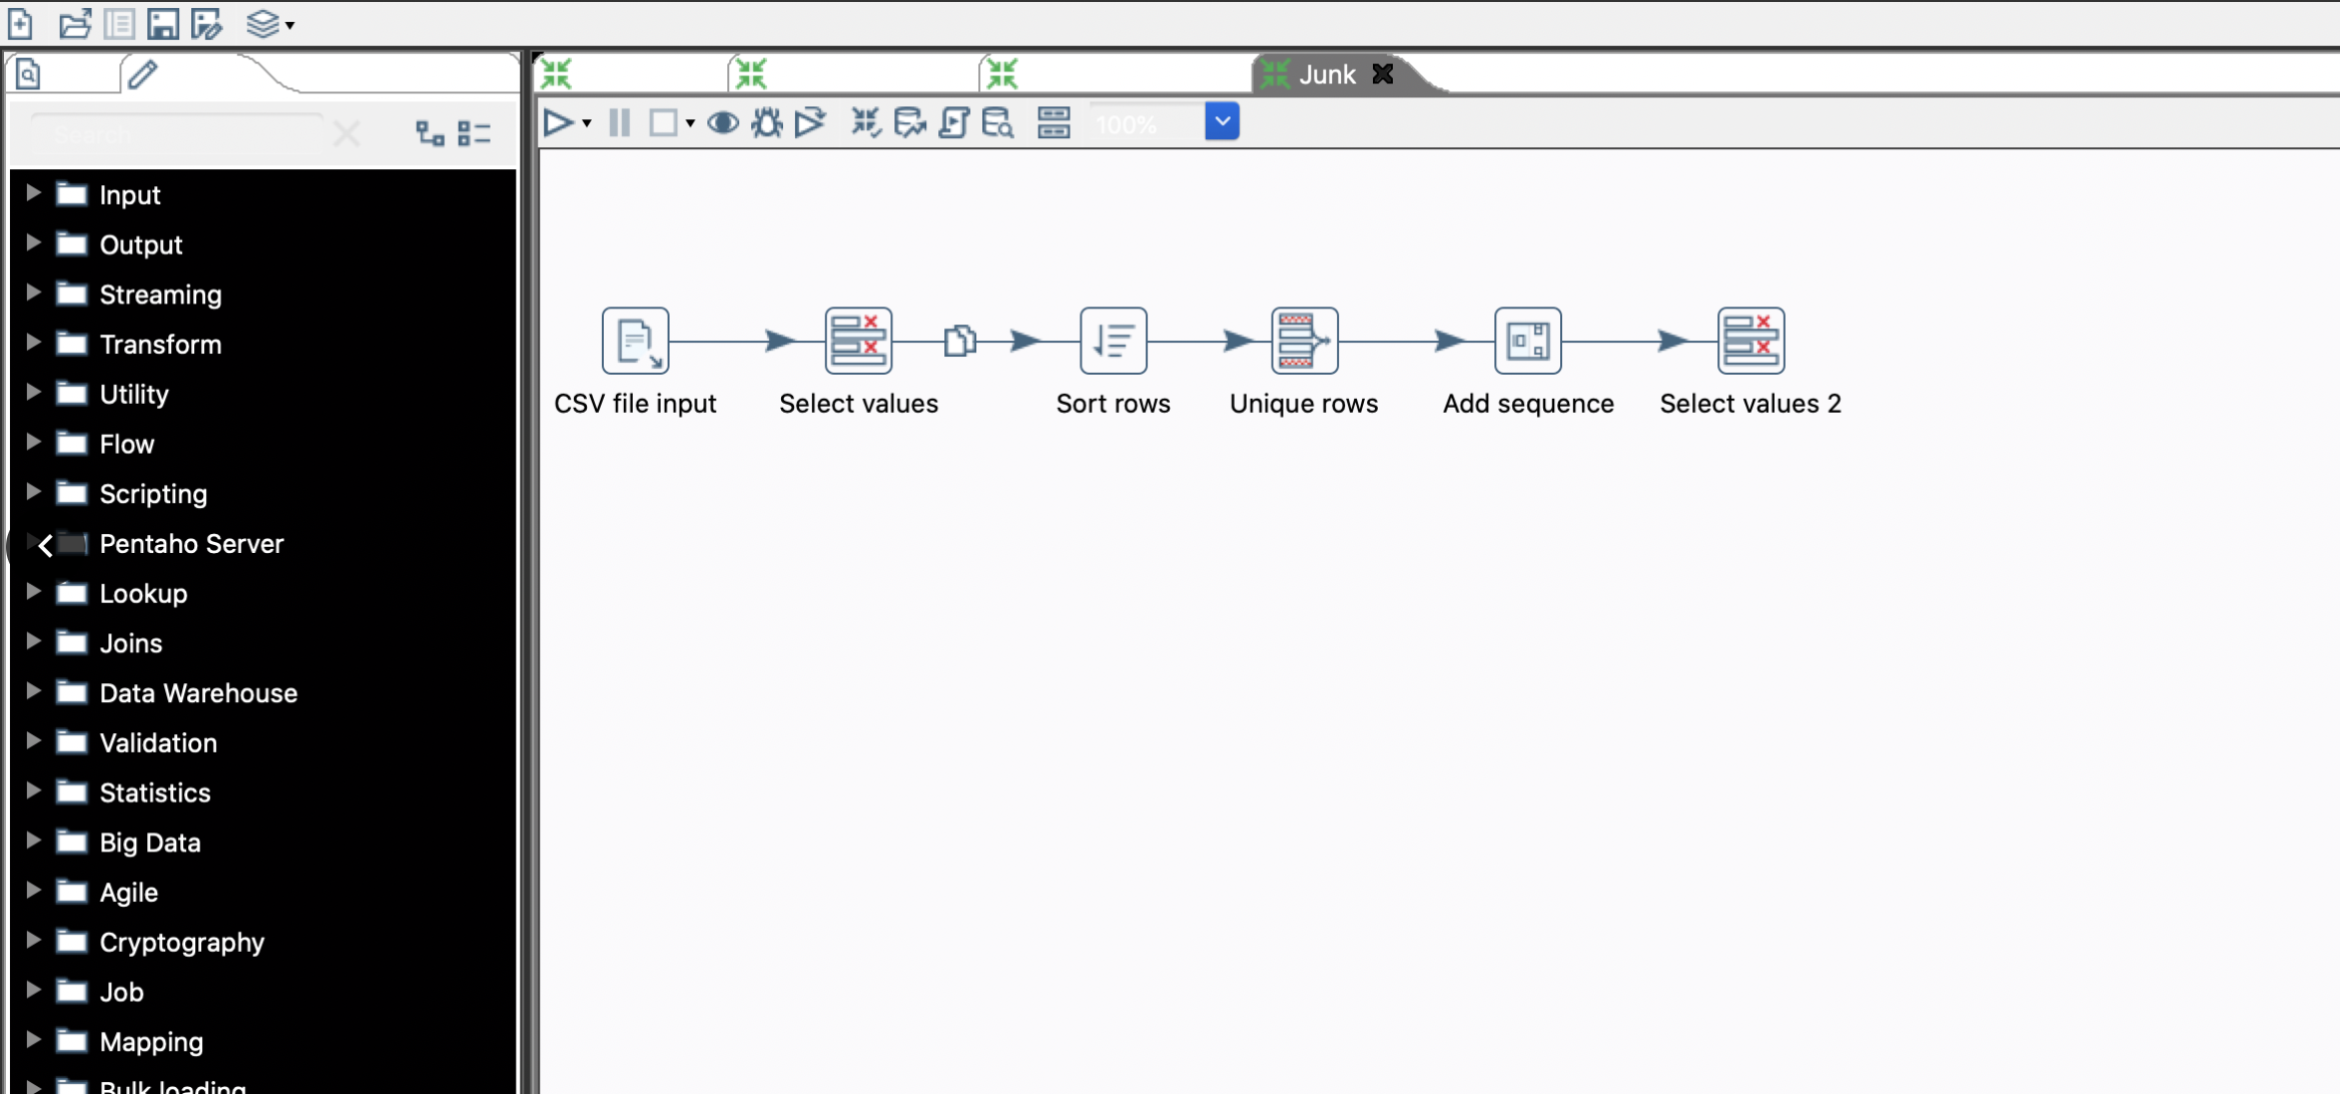
Data Staging Activities - ETL (Includes Data Cleaning and Data Transformation Activities)
Junk Dimensional KTR:
Only present in PECinvoice and junk is created only after PEC invoice is cleaned:
Removed all attributes except Shipping method, order method and payment method.
Sort shipping method, order method and payment method in ascending order.
After removing duplicate rows so we are left with 36 records since the cardinality is 3*3*4.

Slide 14
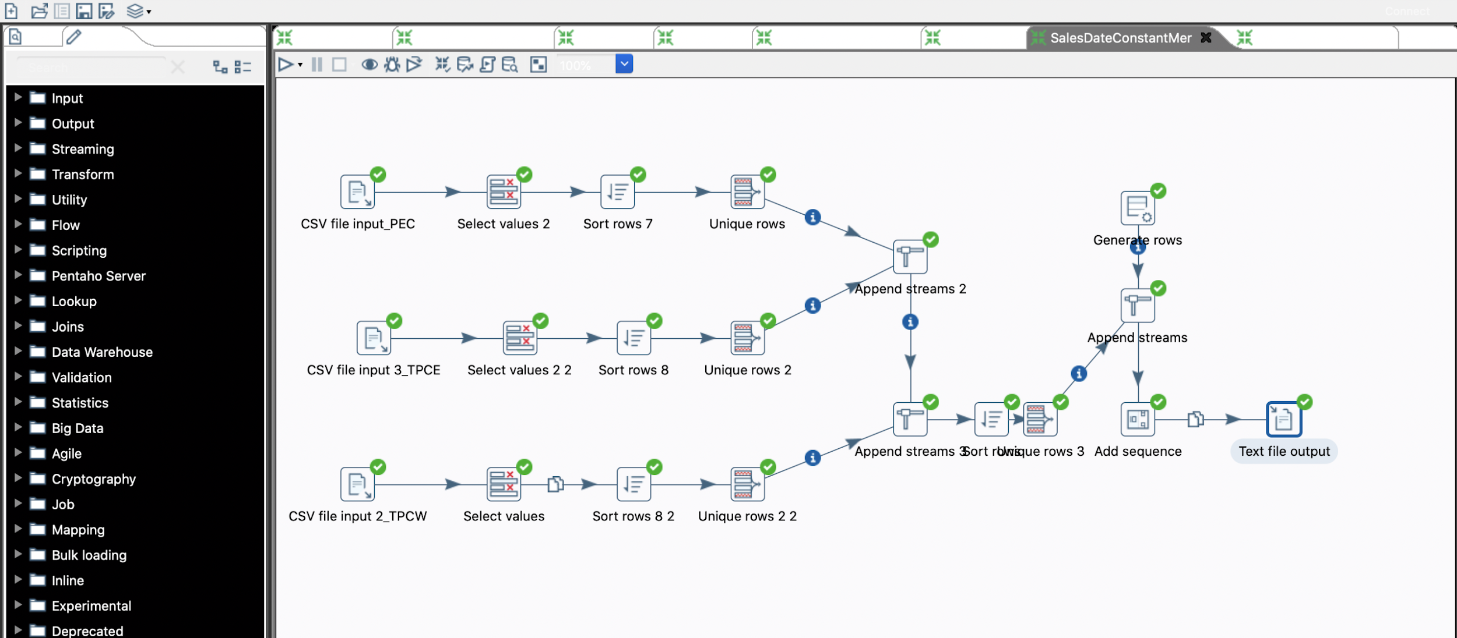
Data Staging Activities - ETL (Includes Data Cleaning and Data Transformation Activities)
SalesDate Dimensional KTR:
TPCW, TPCE, PEC:
1. Remove all the attributes except Sales Date
2. Sort Sales Date in ascending order.
3. Remove Duplicated values using unique rows.
4. Calculated the following values for Year, Quarter, Month, Week, Day, FiscalYear, FiscalQuarter, FiscalMonth, FiscalWeek, FiscalDay,
5. According to the business constraints, the fiscal year, fiscal month, fiscal week and the fiscal day is modified.

Slide 15
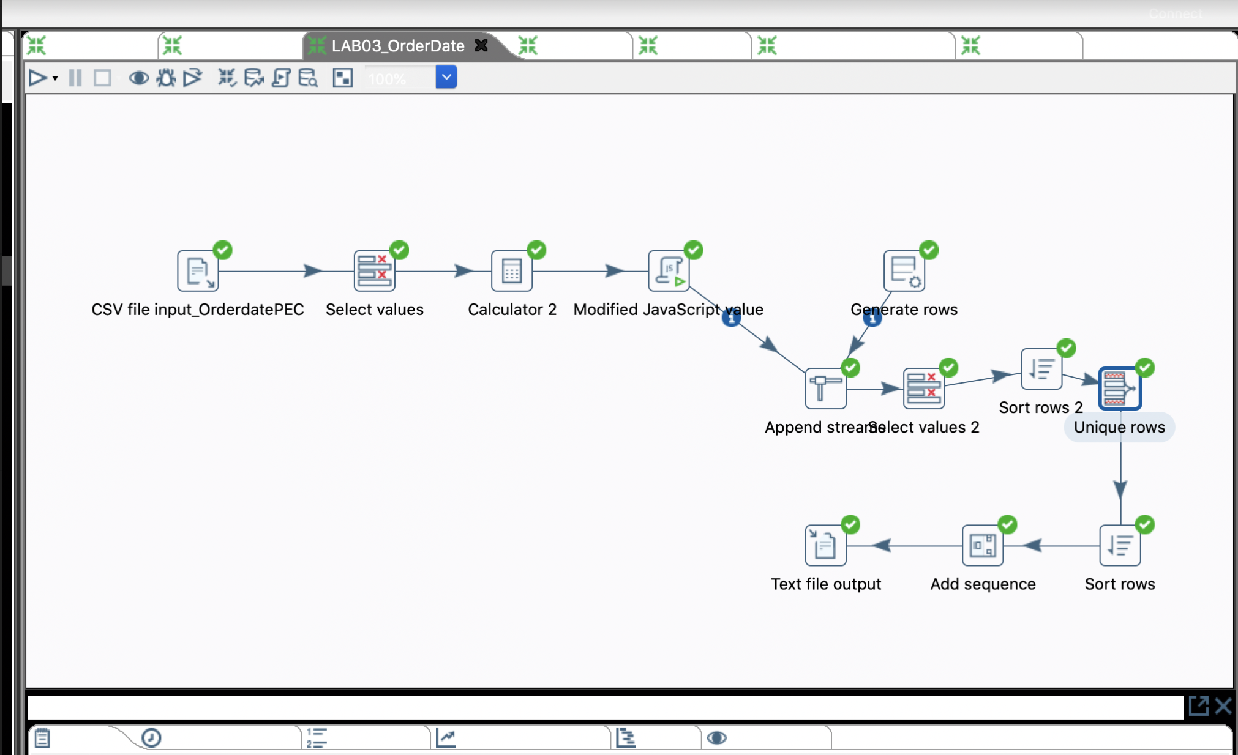
Data Staging Activities - ETL (Includes Data Cleaning and Data Transformation Activities)
OrderDate Dimensional KTR:
TPCW, TPCE, PEC:
1. Remove all the attributes except Sales Date
2. Sort Order Date in ascending order.
3. Remove Duplicated values using unique rows.
4. Calculated the following values for Year, Quarter, Month, Week, Day, FiscalYear, FiscalQuarter, FiscalMonth, FiscalWeek, FiscalDay,
5. According to the business constraints, the fiscal year, fiscal month, fiscal week and the fiscal day is modified.

Slide 16
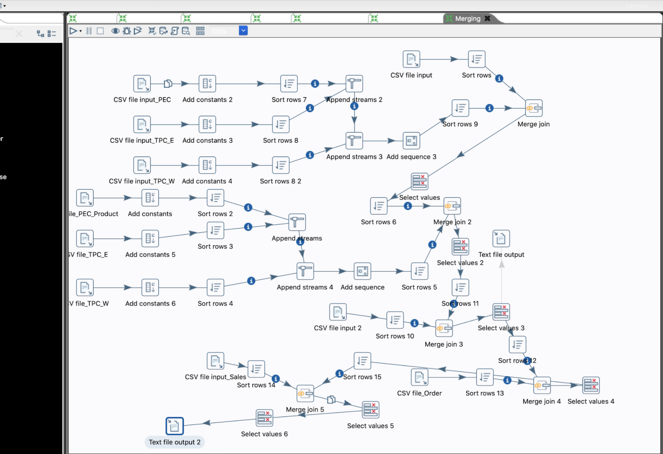
Data Staging Activities - ETL (Includes Data Cleaning and Data Transformation Activities)
Fact Dimensional KTR:

Slide 17
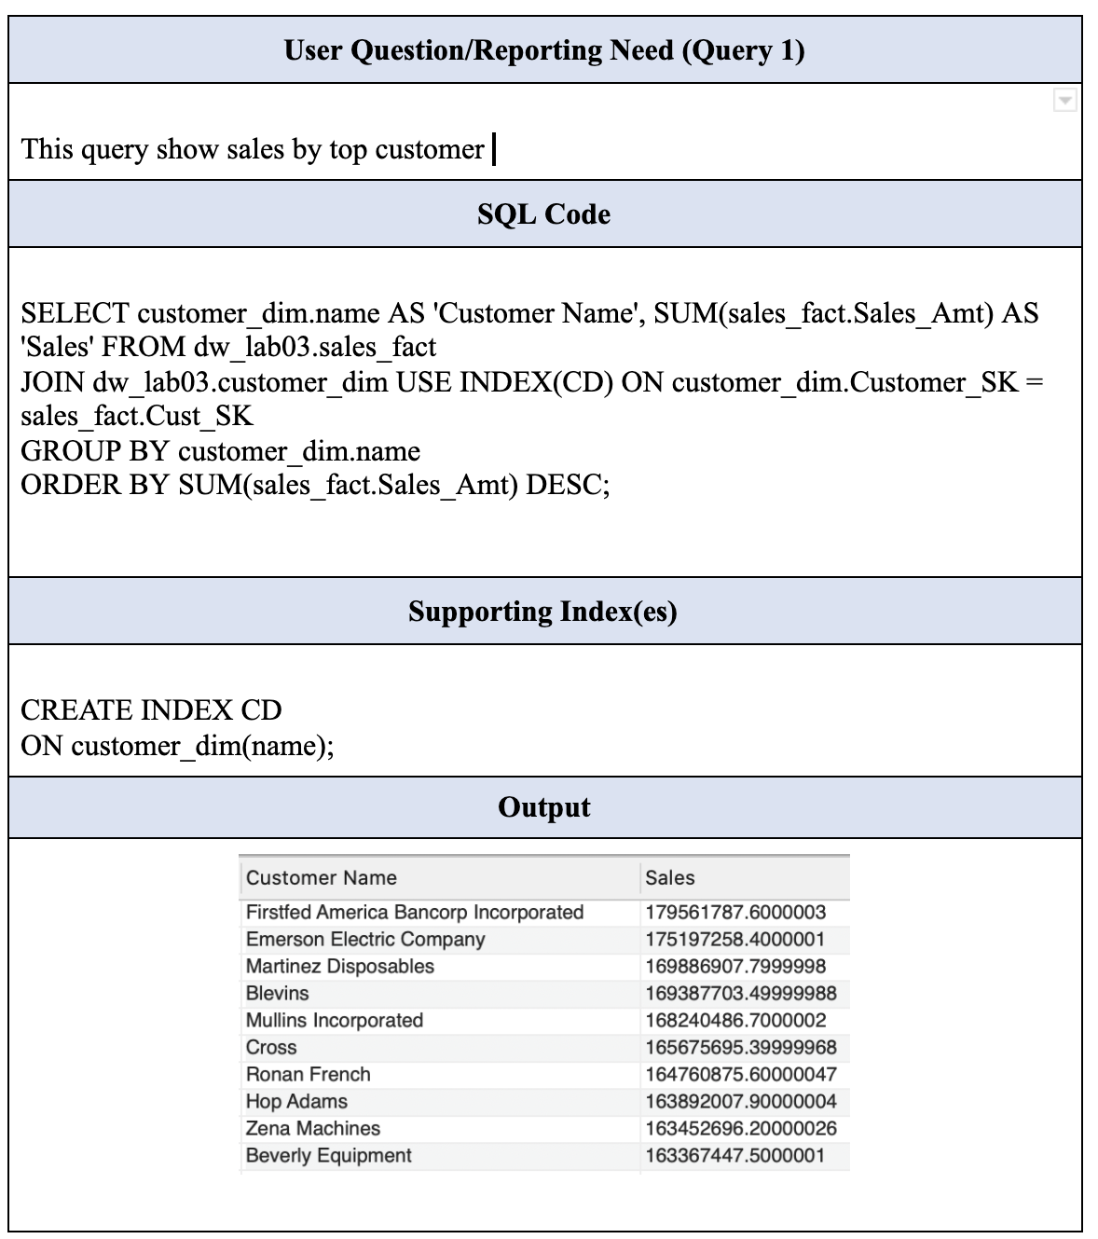
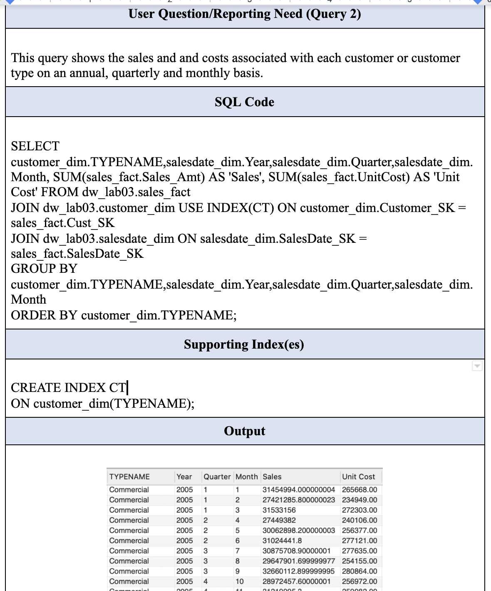
End User Applications - (Queries)

Slide 18
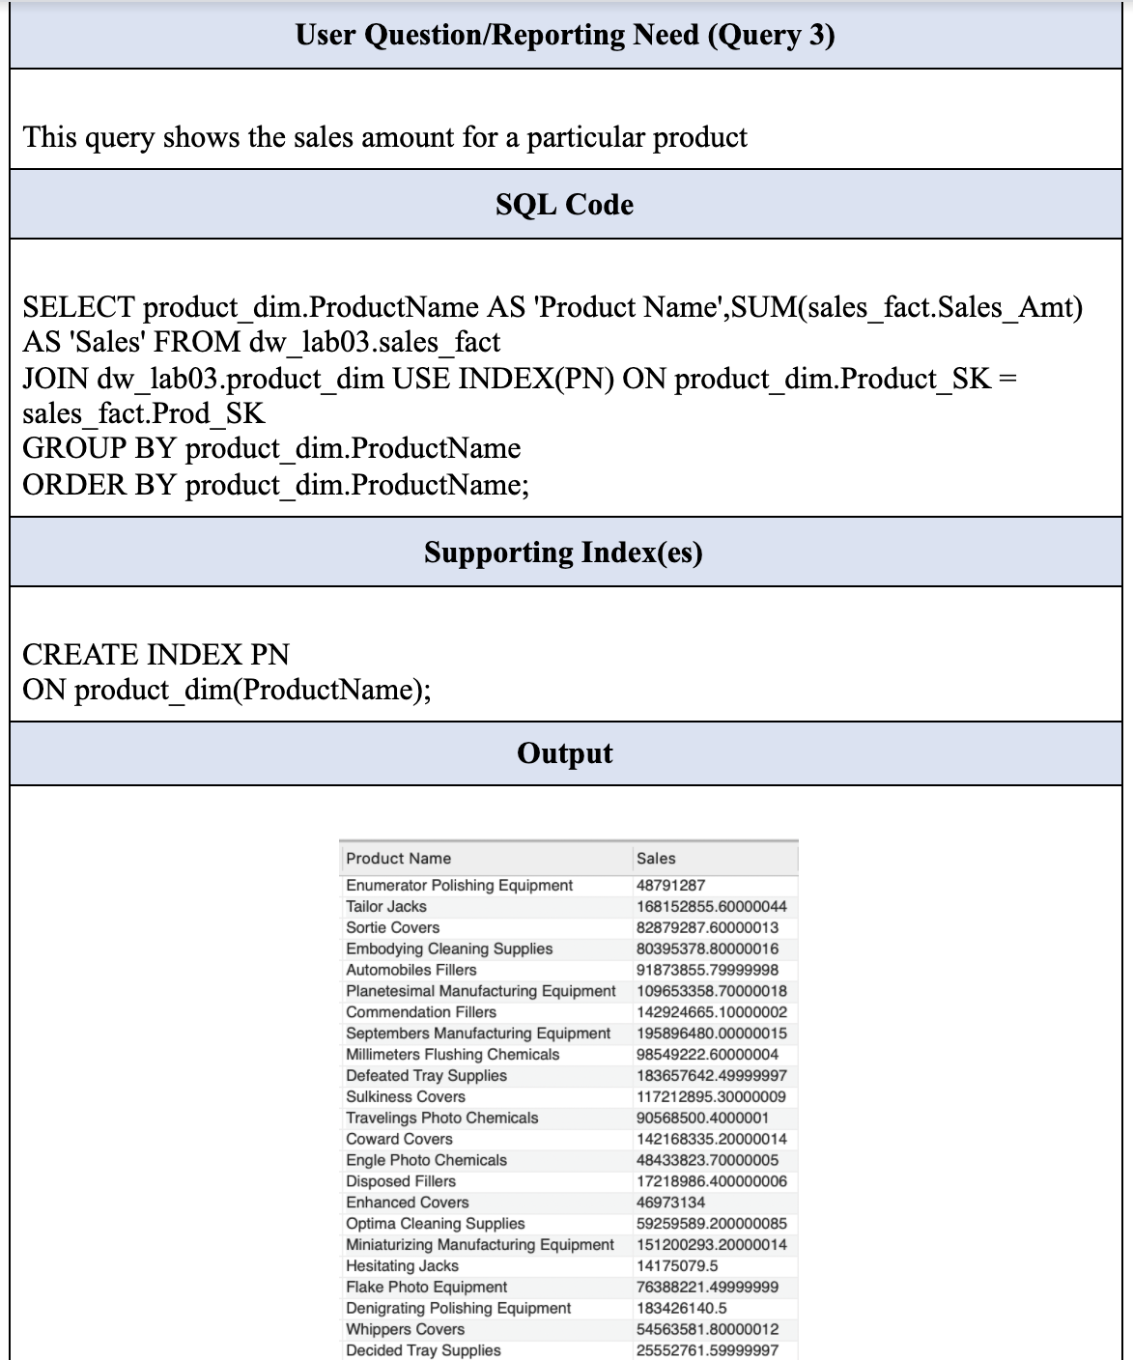
End User Applications - (Queries)

Slide 19
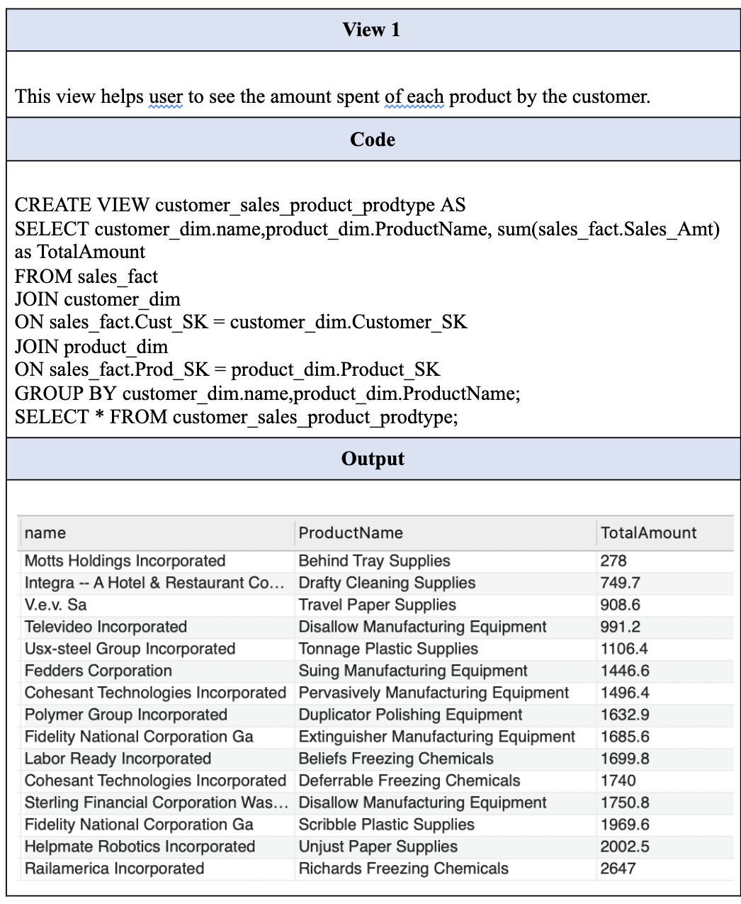
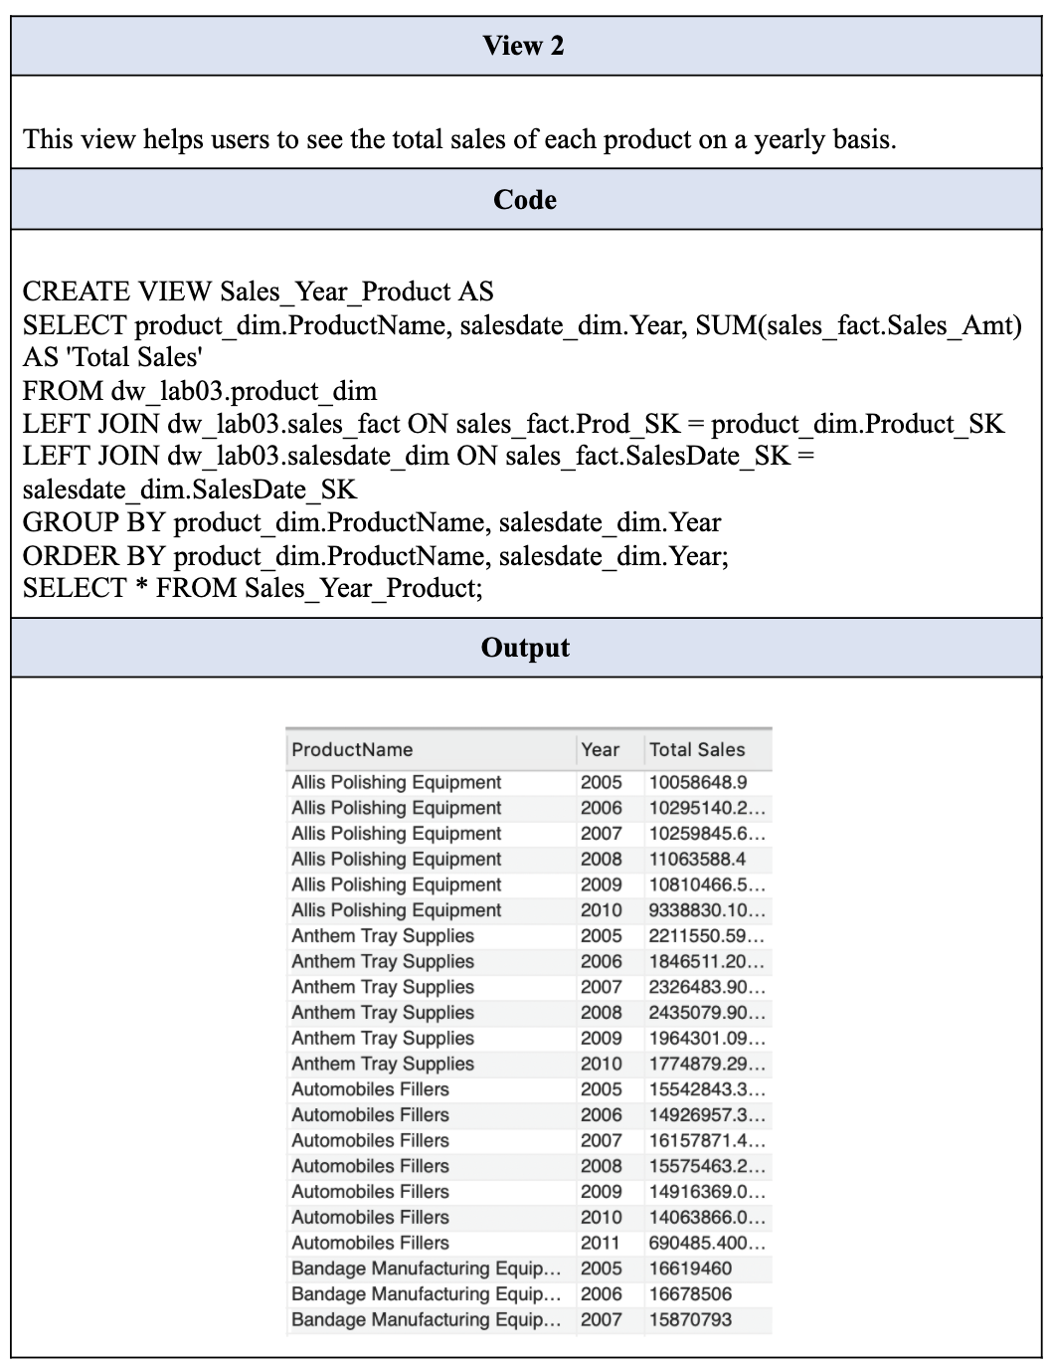
End User Applications - (Views)

Slide 20
Aggregated Data Mart
Lost
Shrunken
Collapsed

Slide 21
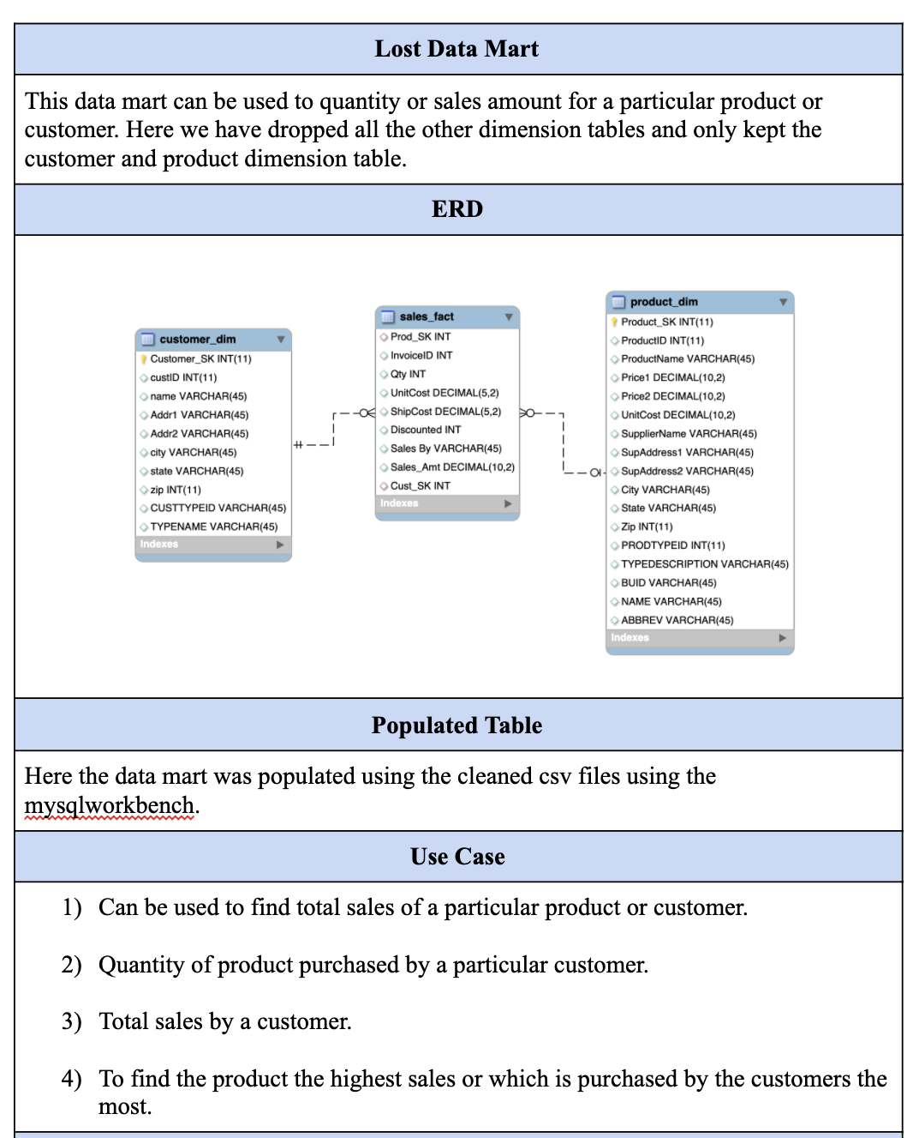
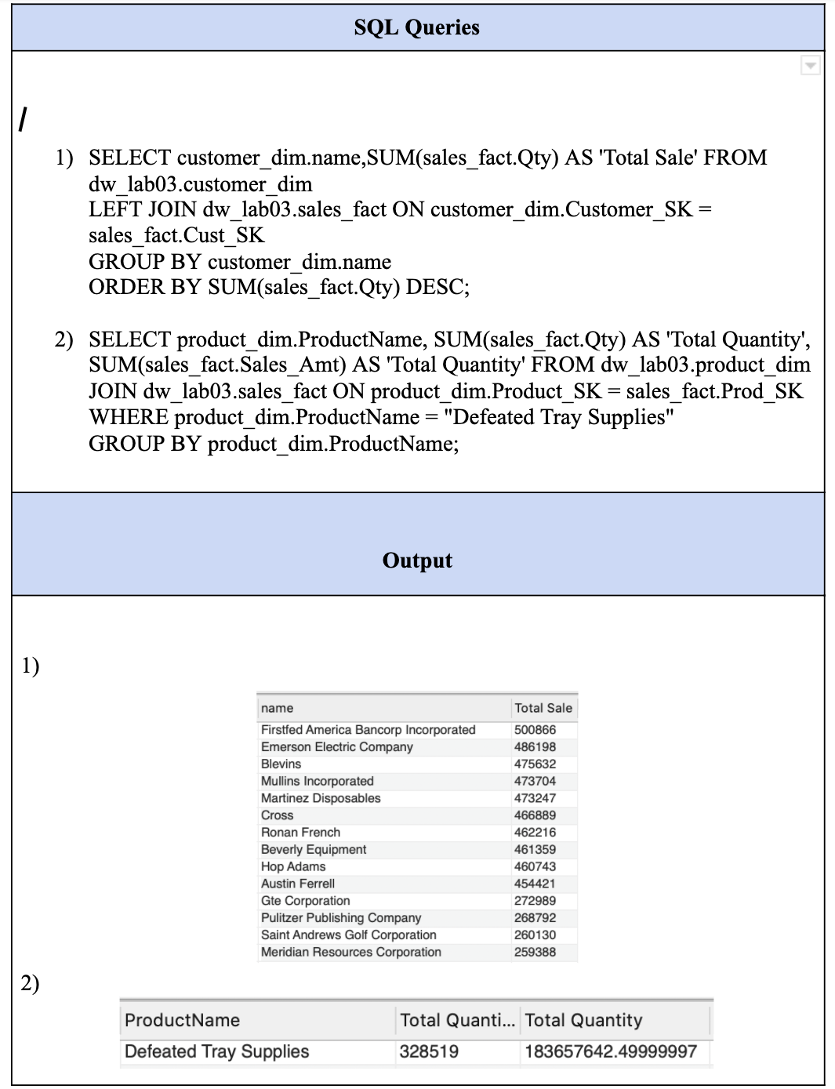
Aggregated Data Mart
Lost Data Mart

Slide 22
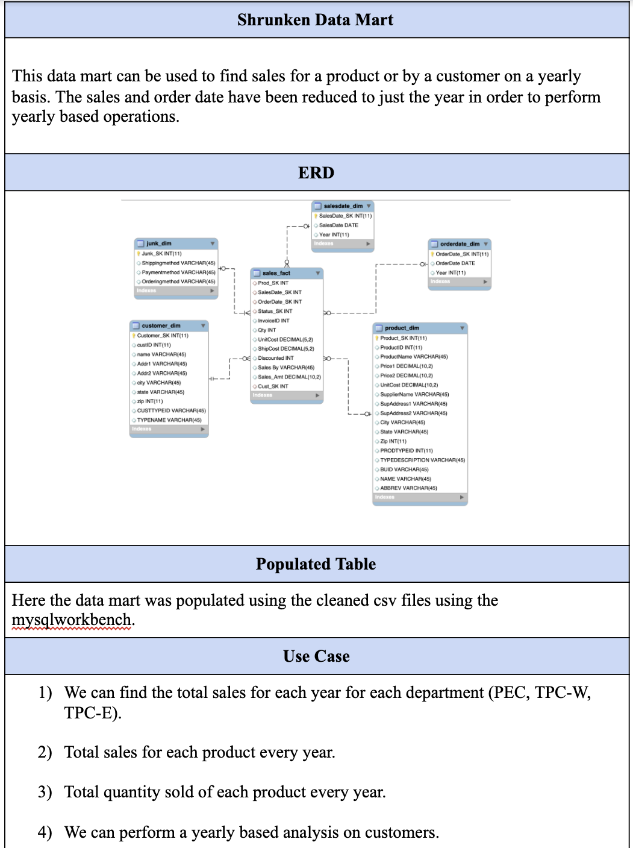
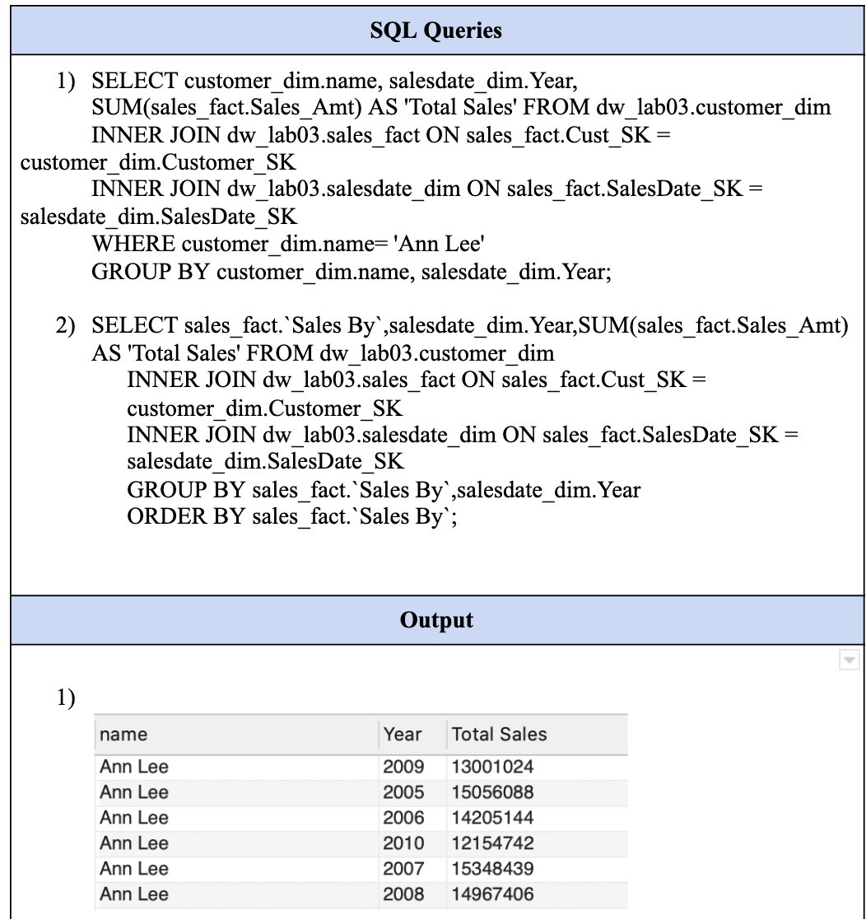
Aggregated Data Mart
Shrunken Data Mart

Slide 23
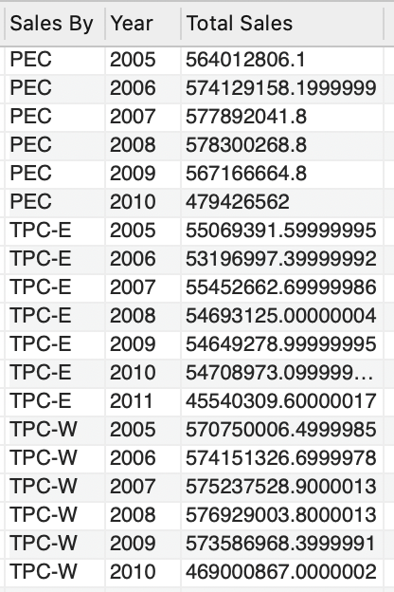
Aggregated Data Mart
Shrunken Data Mart (Cont..)

Slide 24
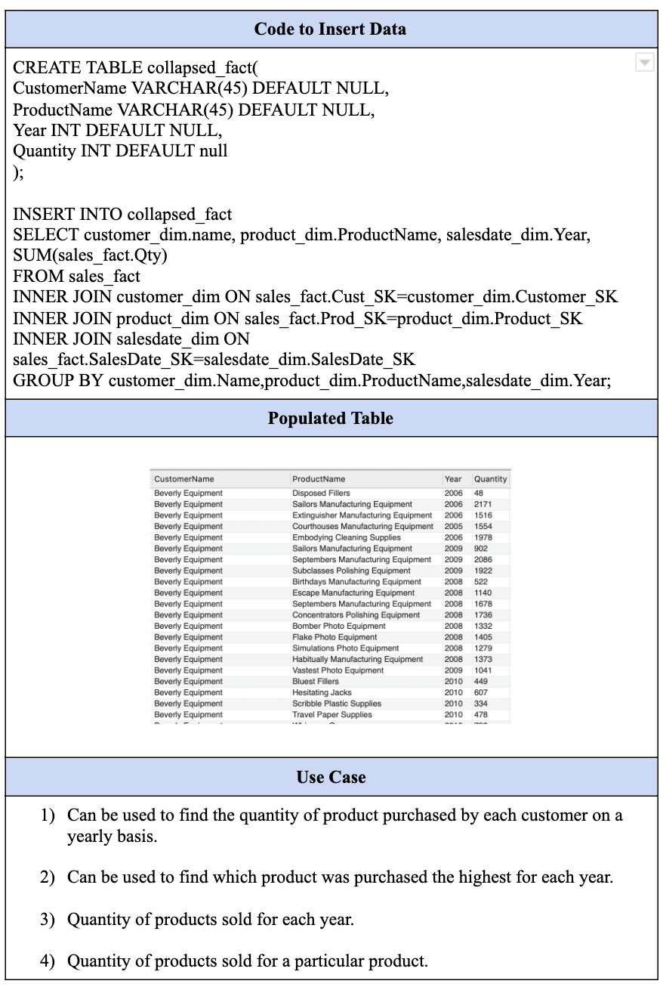
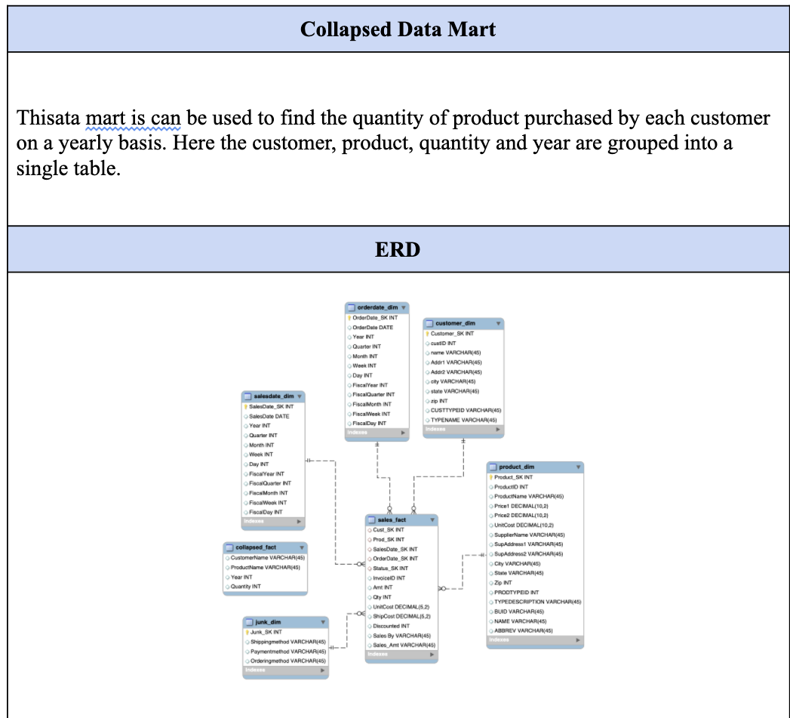
Aggregated Data Mart
Collapsed Data Mart

Slide 25
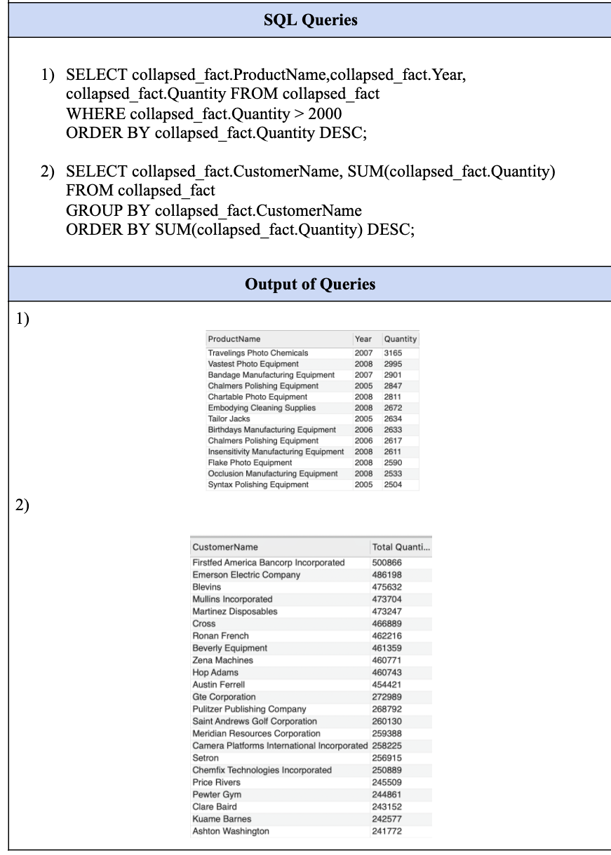
Aggregated Data Mart
Collapsed Data Mart (Cont….)

Slide 26
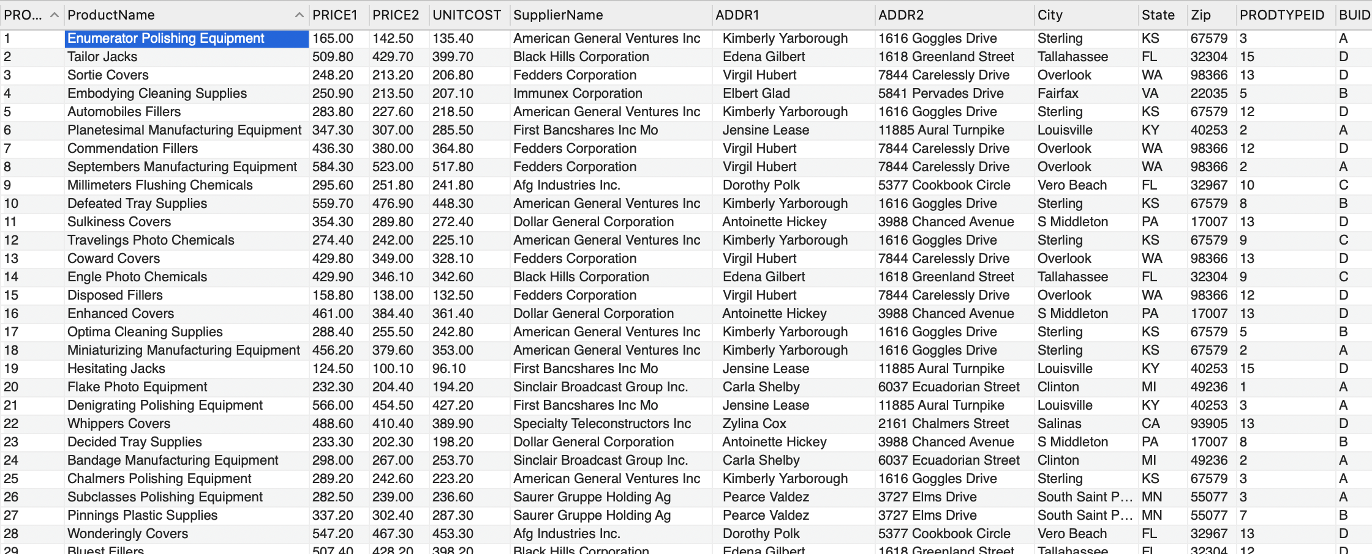
Handling Slowly Changing Dimensions
SCD- Type1
In SCD Type 1 we simply overwrite the existing data since we are not required to keep historical data. In the product dimension table, the product name for prodid = 6 was incorrect so we updated the product name. The image below shows the updated product name and the process of SCD Type 1.

Slide 27
Handling Slowly Changing Dimensions
SCD- Type2
In SCD Type 2 an additional record is created. In this methodology all history of the dimension change is maintained thereby having the original record as well as the updated record. The new record will be assigned a new primary key.
In order to implement SCD Type 2 30 records were taken from the original product dataset with modifications done in the price1 attribute. In order to implement SCD Type 2 we make use of insert. The final output can be seen in the image below.
We are using Pentaho to maintain slowly changing dimensions. In Pentaho, we are taking .csv as input with modified dataset of 30 records and applying dimensional lookup with prodid and source key to different attribute.

Slide 28
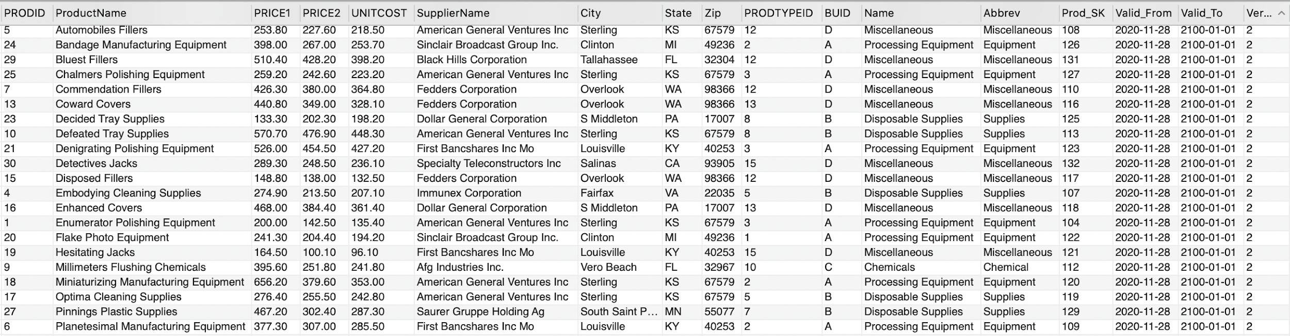
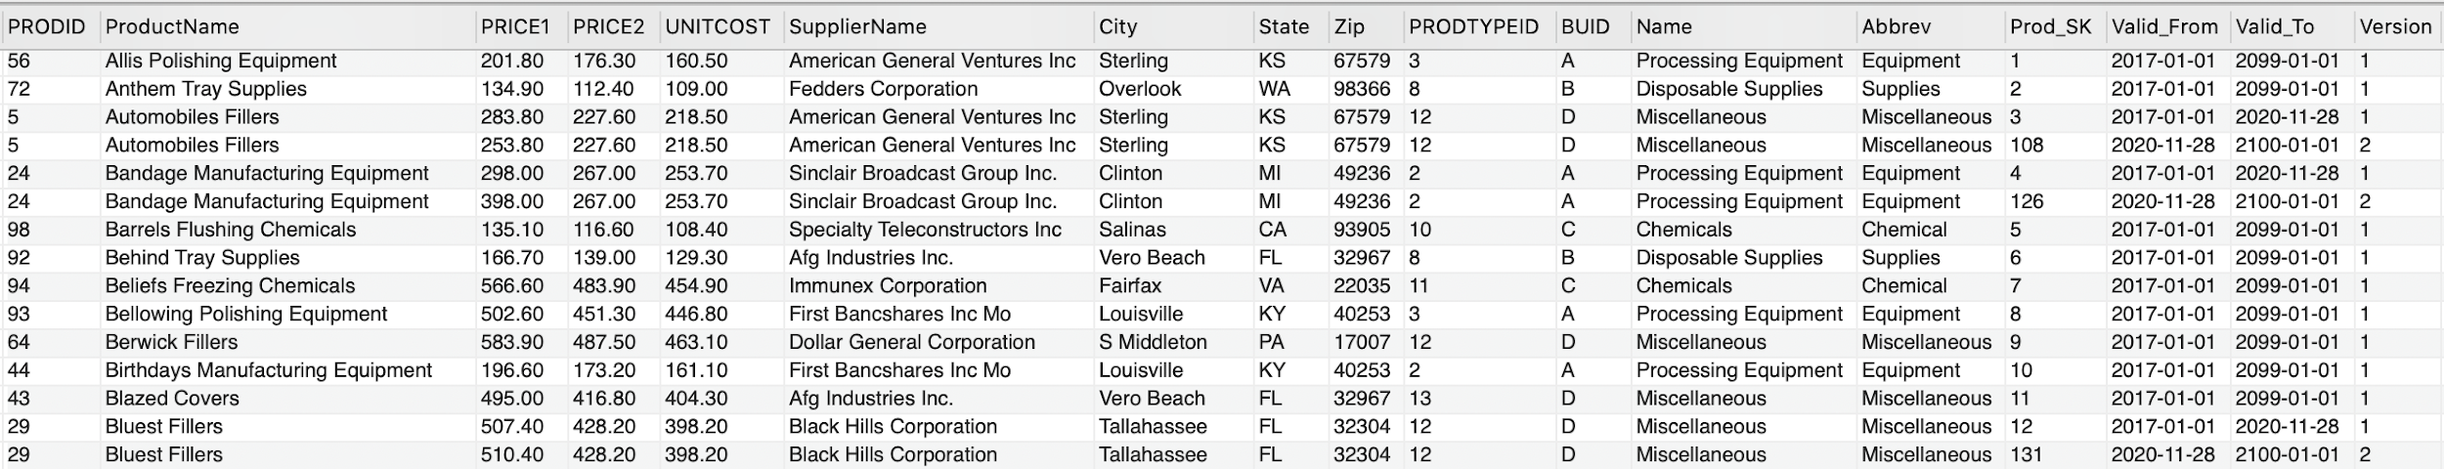
Handling Slowly Changing Dimensions

Slide 29
N-M Implementation
•Parent record in one entity contains several child records in another entity and a vice a versa.
•When there is a need to implement a many to many relationship then the star schema will automatically fall into snowflake model.
•Multiple ways available for many to many relationship.
•In Method 1, we create a separate entity and add attribute IDs to the fact table.
•In Method 2, the many to many relationship is converted into a compound attribute relationship.
•In Method 3, it’s a versatile solution. It simplifies the compound attribute relationship which is in method 2 into the simple attribute relationship. It requires only one of attribute columns in fact table rather than all the columns.

Slide 30
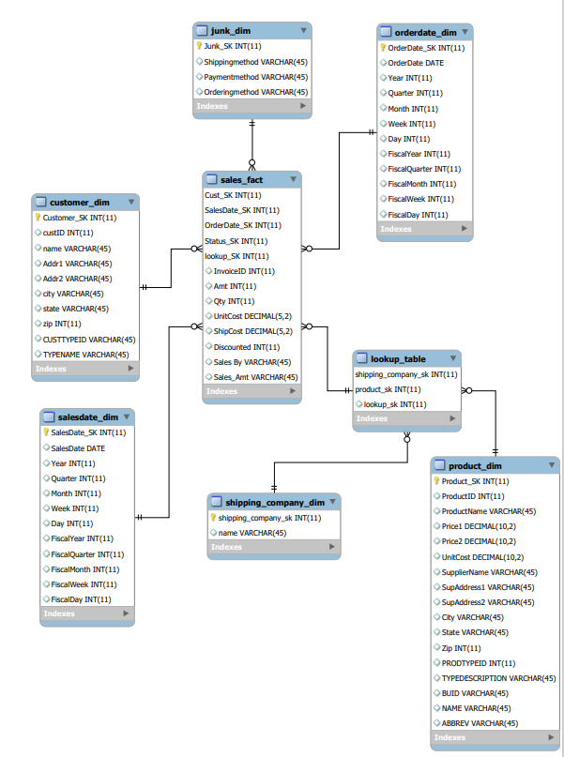
N-M Implementation (ER diagram)

Slide 31
Appendix (Fix Lab #3 Problems)
In Lab-03 deliverables we missed to take care of few points which we rectified in this final submission. The final changes include the following:
Missed the cardinalities relationship:
Now the cardinalities relationship is been set.
Sales Amount computation:
We missed to calculate the sales amount which we rectified by performing computations in the pentaho using calculator for PEC invoice, TPC-W invoice.
Missed to split Department numbers/ Suite numbers:
In TPC-W customer the splitting of Department numbers/ Suite numbers is done correctly and taken care this time using pentaho.
Incorrect discounted field:
For InvoiceID = 45461 as discounted value is missing in TPC-W invoice it’s been handled.
Splitting of address fields:
The address fields are split into Addr1 and Addr2 throughout.
Sales_By field addition:
Added Sales_By field.
Loading of records in the fact table is been handled.

Slide 32
Questions?

Slide 33
THANK YOU

